Slide 1
Transforming Customer Support Through Generative AI
PIP2001 Capstone Project
Review
Batch Number: CSD-G06
Roll No. | Name
20201CSD0117 | V Sreenivas
20211CSD0171 | Basanagouda Dalawai
20221LSD0005 | Syed Dawood
20221LSD0002 | Mohammed Abid Pasha
Under the Supervision of,
Dr./Mr./Ms./Prof. Sandhya L
Professor / Associate Professor / Assistant Professor
School of Computer Science and Engineering
Presidency University
Name of the Program: B-Tech
Name of the HoD: Dr.Saira Banu
Name of the Program Project Coordinator: Assistant Professor. Sandhya L
Name of the School Project Coordinators: Dr. Sampath A K / Dr. Abdul Khadar A / Mr. Md Ziaur Rahman

Slide 2
Content
Problem Statement
Analysis of Problem Statement
Timeline of the Project
References

Slide 3
Problem Statement Number:
Organization: Presidency University
Category (Hardware / Software / Both) : Software
Problem Description: The need for advanced, scalable, and multimodal AI-driven chatbot solutions to transform customer support.
Difficulty Level: High

Slide 4
Analysis of Problem Statement
Technology Stack Components:
Google Gemini Pro : Contextual NLP and generative AI
Coqui-TTS : Realistic audio output generation
OpenAI Whisper : Accurate voice-to-text transcription
Next.js and React : Frontend and backend integration

Slide 5
Analysis of Problem Statement (contd...)
Software and Hardware Requirements:
Software:
Next.js
React
Coqui-TTS
OpenAI Whisper
Hardware:
Servers with GPU capabilities
High-speed internet

Slide 6
Analysis of Problem Statement (contd...)
Current Challenges in Customer Support :
High Inquiry Volume: Difficulty managing large volumes of simultaneous requests.
Lack of Personalization: Generic responses fail to meet individual customer needs.
Limited Accessibility: Few systems support multimodal interactions (text, voice, images).
High Costs: Maintaining large human teams for 24/7 support is expensive.
Response Delays: Manual systems often cause delays, lowering customer satisfaction.

Slide 7
Analysis of Problem Statement (contd...)
2. Opportunities for AI-driven Chatbots :
Advanced NLP: AI models like GPT offer contextual, meaningful responses.
Scalability: Handle multiple queries simultaneously without performance drops.
Multimodal Support: Enable interactions via text, voice, and images for inclusivity.
Cost Efficiency: Reduces dependency on human teams, lowering operational costs.
Real-time Responses: Instant query resolutions enhance customer experience.

Slide 8
Analysis of Problem Statement (contd...)
3. Solution Characteristics :
Generative AI Integration: Use cutting-edge AI for context-aware responses.
Multimodal Capabilities: Incorporate tools for text, speech, and image support.
Customizable & Scalable: Tailor solutions to business needs and scale via cloud infrastructure.
Proactive Assistance: Predictive algorithms to anticipate customer needs.

Slide 9
Analysis of Problem Statement (contd...)
4. Expected Benefits :
Improved Customer Experience: Faster, accurate, and personalized support.
Accessibility: Multimodal interactions enhance inclusivity.
Cost Reduction: Automation reduces operational expenses.
Competitive Edge: Positions businesses as customer-focused and innovative.

Slide 10
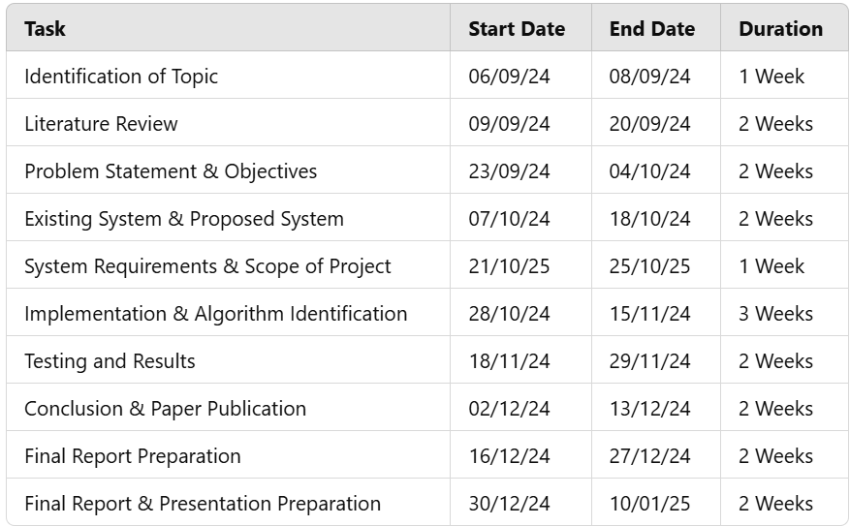
Timeline of the Project (Gantt Chart)

Slide 11
References (IEEE Paper format)
Shekhar, E. S., Goyal, D. S., & Jain, U. (2024). Enhancing customer engagement with AI and ML: Techniques and case studies. International Journal of Computer. Retrieved from academia.edu
Ekechi, C. C., Chukwurah, E. G., Oyeniyi, L. D., & Others. (2024). AI-infused chatbots for customer support: A cross-country evaluation of user satisfaction in the USA and the UK. International Journal of .... Retrieved from fepbl.com
Behera, R. K., Bala, P. K., & Ray, A. (2024). Cognitive chatbot for personalized contextual customer service: Behind the scene and beyond the hype. Information Systems Frontiers. Springer.
Alexander, T. (2024). Proactive customer support: Re-architecting a customer support/relationship management software system leveraging predictive analysis/AI and machine learning. Engineering: Open Access. Retrieved from opastpublishers.com
Banik, B., Banik, S., & Annee, R. R. (2024). The role of AI in enhancing customer engagement and loyalty. Revista de Inteligencia Artificial en .... Retrieved from redcrevistas.com
Maj, M., Dmowski, A., Nowak, R., & Mędzelowski, T. (2024). Enhancing customer service in shopping malls with an advanced chatbot-integrated concierge device. Retrieved from um.edu.mt
Arya, S., Bhaskar, A., & Gupta, K. (2024). Conversational AI: A treatise about vying chatbots. 2nd International .... IEEE Xplore.
Bhattacharyya, S. S. (2024). Study of adoption of artificial intelligence technology-driven natural large language model-based chatbots by firms for customer service interaction. Journal of Science and Technology Policy. Retrieved from emerald.com
Genie: Enhancing information management in the restaurant industry through AI-powered chatbot. Retrieved from um.edu.mt
Katragadda, V. (2023). Automating customer support: A study on the efficacy of machine learning-driven chatbots and virtual assistants. IRE Journals. Retrieved from irejournals.com

Slide 12


